Slide 1

10. Application For Grocery Delivery

Slide 2


Application For Grocery Delivery
A grocery delivery website or application is among the best projects for full-stack developers to showcase their talent and skills. You can learn multiple factors related to large-scale full-stack apps or websites by making the grocery delivery application project. It involves back-end knowledge and helps you excel in making major projects in the future.

Slide 3
YOUR PROJECT NAME
Application For Grocery Delivery
USERNAME | NAME | BATCH
2108a2989 | Sakila banu. M | A29
2108a2991 | Shobana.M | A29
2108a2992 | Sneha. R | A29
2108a2104 | Vidhya. M | A29

Slide 4
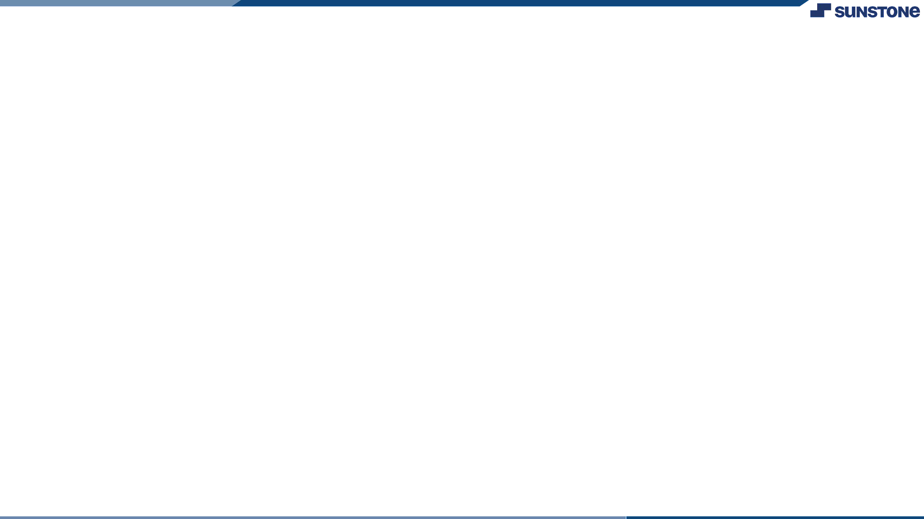
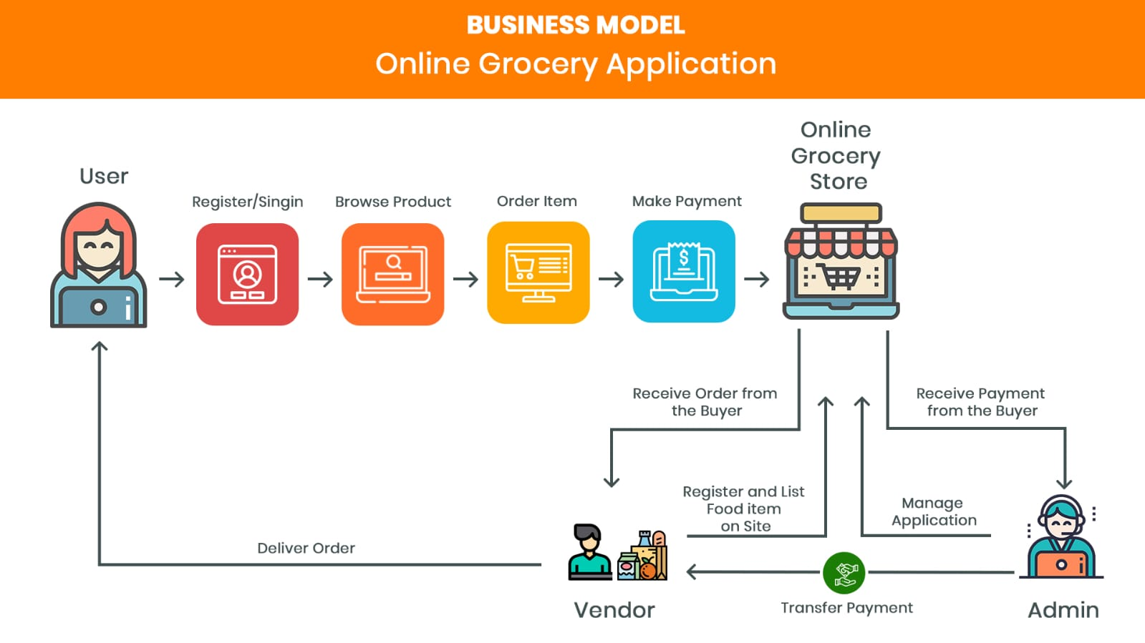
Task 1 :: SDP (Module 1)

Slide 5
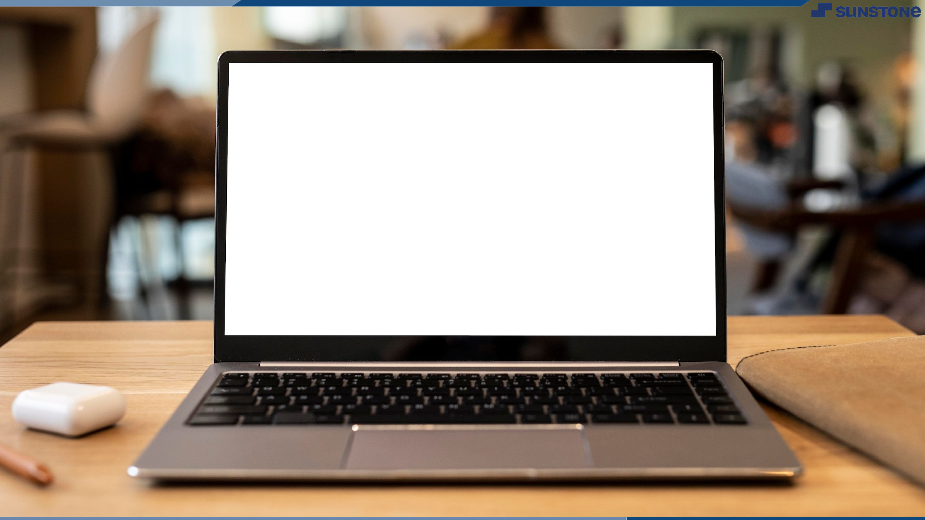

delivery
Application For Grocery
Click here

Slide 6


